Slide 1
Sell Presentation
TMT
Alan Michaan, Andrew Shon, Cailan Ashcroft, David Tsui, Diana Fu and Mikhail Stepanov
March 11th, 2015

Slide 2
Disclaimer
The analyses and conclusions of the Western Investment Club (“WIC") contained in this presentation are based on publicly available information. WIC recognizes that there may be confidential information in the possession of the companies discussed in the presentation that could lead these companies to disagree with WIC’s conclusions. This presentation and the information contained herein is not a recommendation or solicitation to buy or sell any securities.
The analyses provided may include certain statements, estimates and projections prepared with respect to, among other things, the historical and anticipated operating performance of the companies, access to capital markets and the values of assets and liabilities. Such statements, estimates, and projections reflect various assumptions by WIC concerning anticipated results that are inherently subject to significant economic, competitive, and other uncertainties and contingencies and have been included solely for illustrative purposes. No representations, express or implied, are made as to the accuracy or completeness of such statements, estimates or projections or with respect to any other materials herein. Actual results may vary materially from the estimates and projected results contained herein.
The sole responsibility for the content of this publication lies with the authors. Its contents do not reflect the opinion of the University Students’ Council of the University of Western Ontario (“USC”). The USC assumes no responsibility or liability for any error, inaccuracy, omission or comment contained in this publication or for any use that may be made of such information by the reader.

Slide 3
Business Overview
AMBA develops semiconductor chips for video and audio processing worldwide
Ticker | NASDAQ: AMBA
Current Price | $66.61
Market Cap | $1.95B
P / E (NTM) | 28.7x
EPS (TTM) | $1.19
52 Week Range | $21.60-68.50
Price:
$65.81
Ambarella is a developer of solutions for video, participating in several high-growth end markets including: Automotive “Dash Cams”, Wearable Sports Cameras, Ultra High Definition TV’s, Video Surveillance Cameras, Infrastructure Video Solutions
Fabless semiconductor company whose main product is their flagship system-on-a-chip
Largest clients of Ambarella include: GoPro, Xiaomi, Cisco, and Motorola
Business model revolves around a profit model supported by a continuous development of successful chips and earning design wins from ODM’s and OEM’s

Slide 4
Analysis of Buy Thesis (September 2013)
Most of the thesis has been realized – most upside remains in a growth thesis
Best-in-class video SoC technology with historically proven management
4/5 end markets are posed for explosive growth (20%+ CAGR) in medium term
Few pure-play competition; only semiconductor company that is specialized in these particular markets
Clean balance sheet, strong position $118M with no debt outstanding
Undervalued with regards to P/E and EV/EBITDA compared to SoC peer group

Slide 5
Sell Thesis
Multiples and intrinsic valuation indicate that AMBA is no longer a value play
2014 FY Performance
Sell Thesis and Recommendation
Ambarella is no longer a value investment based on its peers and intrinsic valuation
Forward EV / EBITDA multiples are trading ~67.2% higher than the overall median of its SoC peers, and the DCF analysis indicates overvaluation by ~16.1%
Xiaomi recently released a GoPro competitor (Yi Action Camera) that sells for half the price of the GoPro Hero ($64 vs. $130) and has more impressive performance specs
Xiaomi has publicly stated that it negotiates component cost decreases with its suppliers in order to have the ability to sell its products at a low price but remain profitable
GoPro represents ~25-30% of AMBA’s revenue; AMBA is also developing Xiaomi chips, but the cheaper competitor could push out GoPro and bully Ambarella into lowering its prices
Digital video cameras and camcorders are declining in popularity due to the rise of convenient and high quality smartphone video capture capabilities
These cameras still represent a significant portion of revenue for Ambarella (~15-20%)
Recommendation for AMBA: SELL at $66.61
Notes:
Universities, lawyers, pharma
Innovatin act – specifically targeted at trolls – restrictions on filing a patent infringement lawsuit – more difficult to file a vague claim

Slide 6
Internal Analysis
Recent trends in Ambarella’s financial performance and gross margins
2014 FY Performance
Ambarella has been experiencing a gradual decrease in its profitability over time
Gross margin on a non-GAAP basis for the most recent quarter in fiscal 2014 was 63.8%, this can be compared with a margin of 68.5% for the same period in fiscal 2013
Ambarella management also stated in a conference call that they expect their sales growth to slow down in the first half of 2015, resulting in loss of top-line revenue
Margin Analysis
Devices like cameras and audio/video chip technology become commoditized quickly; there is currently fierce pricing competition from large chip manufacturers
Moving forward, it is likely that Ambarella’s pricing strategy will face immense pressure
Operating expenses, which stand today at 43% and inline with estimates, are expected to increase; as transistors decrease in size (Moore’s Law), they become more expensive
COGS as a percentage of sales is slowly increasing (33% to 36% from 2013 to 2014)

Slide 7
Internal Analysis
Ambarella faces certain competitive pressures from other larger chip makers
Competitive Pressures
Even though AMBA has strong competitive advantages and certain barriers of entry, it might still be susceptible to threats from well-established, large-size tech companies
A recent trend of consolidation in the Semiconductor sector places certain threats on Ambarella as they are one of the smaller players in this particular space
AMBA doesn’t have the economies of scale to compete with many larger firms
To remain competitive in this industry, consistently investing significant funds into research and development is critical to generating new and improved product lines
Ambarella may not be able to keep up with the rapidly changing trends in the Semiconductor space and could potentially lag behind larger manufacturers
The continuous uncertainty surrounding the Client Base and the decreasing margins indicates that Ambarella could be a fairly speculative investment at the moment

Slide 8
External Analysis
Market dynamics in the SoC semiconductor space
Market Dynamics
Companies are greatly subjected to their consumers
The companies partners, GoPro and recently Xiaomi, compete with other video cameras in a very competitive market. For example, Apple recently got their patent application for wearable cameras approved
The industry develops at a fast pace
As technology advances, more will be demanded of these small semiconductors each year and thus fewer chips will be demanded
It is difficult for a company to keep up with innovation, to match the need for increasing processing speeds
There are few barriers to entry, in the designing industry
Designing, rather than manufacturing, requires little start-up costs and is highly dependent on the skill of its employees, rather than the value of its capital, which is much cheaper

Slide 9
External Analysis
Overview of players in the sub-industries Ambarella currently competes in
Competitive Analysis
Camera Market Industry
CSR Plc (who acquired Zoran Corporation in August 2011), Fujitsu Limited, HiSilicon Technologies Co., Ltd. and Texas Instruments Incorporated
Division of OEMs
Canon Inc., Panasonic Corporation and Sony Corporation.
Infrastructure
Intel Corporation, Magnum Semiconductor, Inc. and Texas Instruments Incorporated.
Key Success Factors
Constant technological advances: It’s difficult for AMBA to keep up with the technological advances of larger companies, because of its smaller R&D budget
Eg. AMBA spent 31% of total revenue on R&D last year, while QCOM only spent 21%
Competitive pricing: Companies that do not outsource the production of their semiconductors have lower costs and can thus compete better on pricing

Slide 10
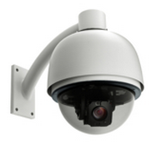
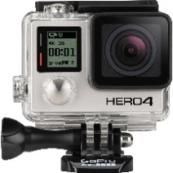
External Analysis
Overview and industry trends in Ambarella’s end markets
End Markets Show Potential - But When?
UHDTV (Broadcast Infrastructure Solutions)
There are concerns regarding the supply chains’ capabilities to continuously generate new UHD content & services for consumers
Automotive Cameras
There is potential growth within this industry, primarily in the Asia-Pacific region however we expect consumer adoption to be fairly slow
IP Security Cameras
One of the faster growing end markets for Ambarella: industry research shows an estimated CAGR of 19.95% from 2014-2020
Wearable Cameras
An important source of revenue generation for Ambarella (over ~30% of the revenue); 2 dominant clients (GoPro and XiaoMi)

Slide 11
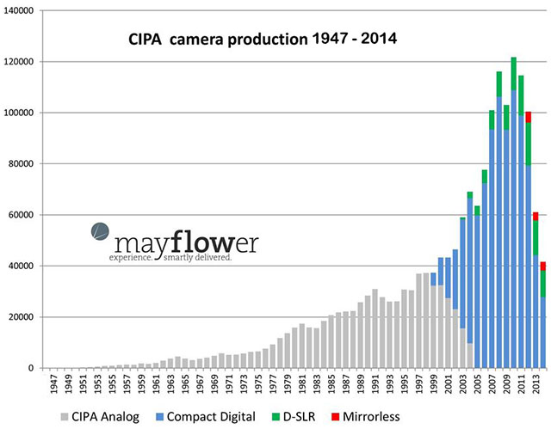
External Analysis
Ambarella’s primary subsector of decline is in the hand-held digital cameras
Industry Trends
CIPA Camera Production (1947-2014)
The popularity of the handheld digital camera and camcorders has been in straight decline in the recent past
Digital camera shipments by Japanese manufacturers have been in over 29 consecutive months of decline (2014)
Shipment volume declined 32.5 percent in Europe, 41.9 percent in the Americas, 21.9 percent in Asia, and 27.4 percent in other regions (2014)
While there is the potential for expansion in Ambarella’s other subsectors, the growth potential is more speculative than the very evident decline in the digital camera segment

Slide 12
Comparable Companies Analysis
AMBA appears to be significantly overvalued on an EV / EBITDA and P / E basis
Comparable Companies Analysis

Slide 13
Discounted Cash Flows Analysis
Discounted Cash Flows Analysis shows considerable downside for AMBA
Discounted Cash Flows Analysis
WACC
WACC

Slide 14
Recommendation
Recommendation for AMBA
SELL at $66.61

Slide 15
Sell Presentation
TMT
Alan Michaan, Andrew Shon, Cailan Ashcroft, David Tsui, Diana Fu and Mikhail Stepanov
March 11th, 2015

